Slide 1
Environmental Pollution
Understanding the Crisis

Slide 2
The Many Faces of Pollution
- Air Pollution: Emissions from vehicles, industries, and wildfires contribute to air pollution, affecting respiratory health and climate change.

Slide 3
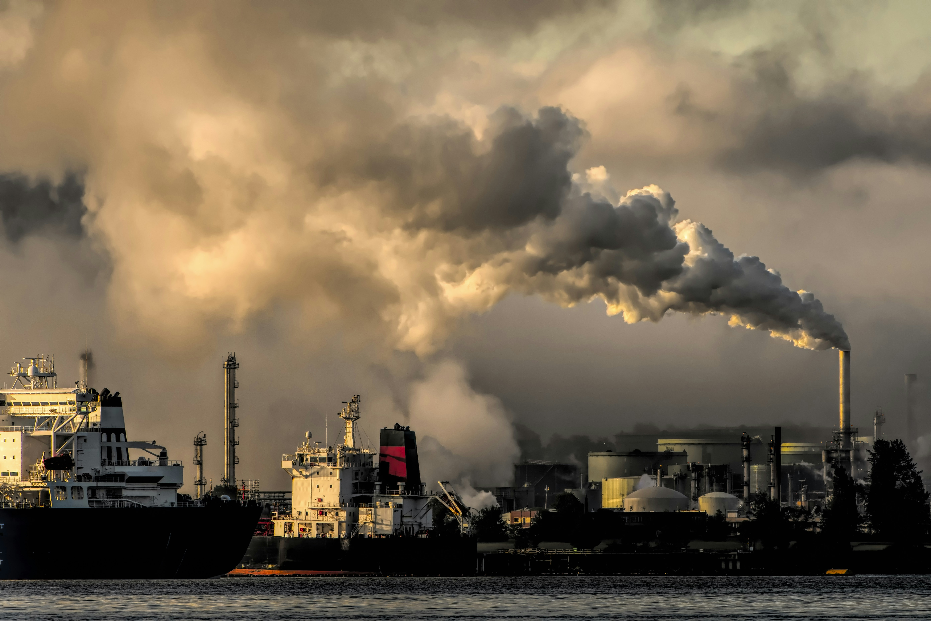
Visualizing Air Pollution

Slide 4
Causes and Effects of Water Pollution
- Industrial Waste: Factories discharge toxic chemicals into rivers and oceans, endangering marine life and contaminating drinking water sources.

Slide 5
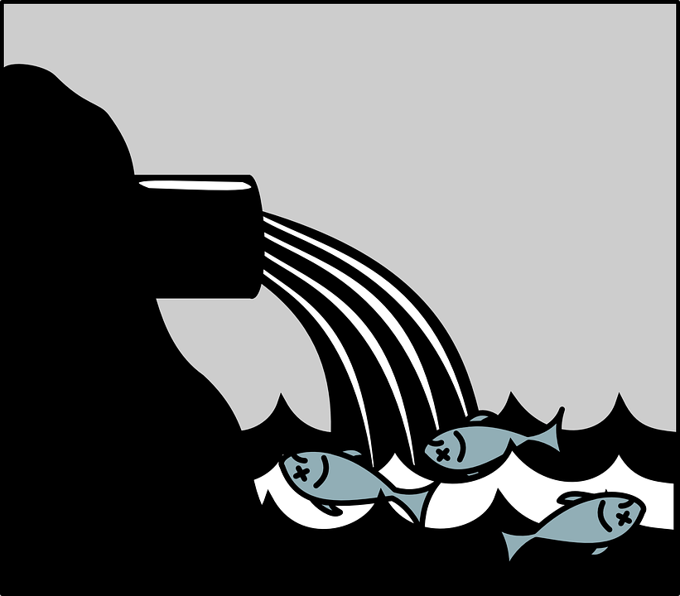
Impact of Water Pollution

Slide 6
Soil Pollution: A Hidden Crisis
- Improper Waste Disposal: Landfills and illegal dumping contaminate soil with hazardous substances, impacting nearby water sources and ecosystems.

Slide 7
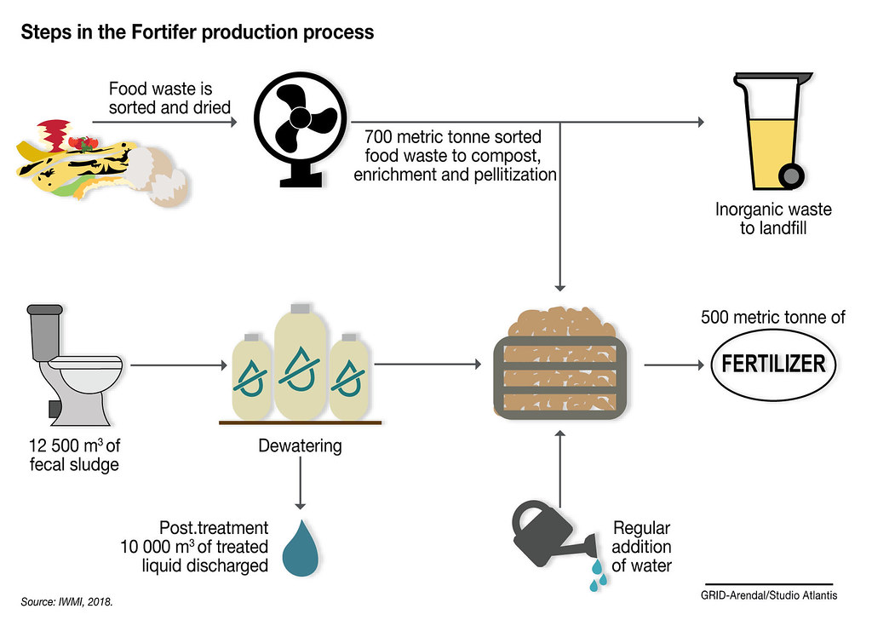
Restoring Polluted Soil

Slide 8
Climate Change and Pollution
- Greenhouse Gas Emissions: Air pollution contributes to climate change, with carbon dioxide and methane being the primary culprits.

Slide 9

The Melting Arctic

Slide 10
Health Impacts of Pollution
- Respiratory Issues: Air pollution increases the risk of asthma, bronchitis, and other respiratory diseases.

Slide 11
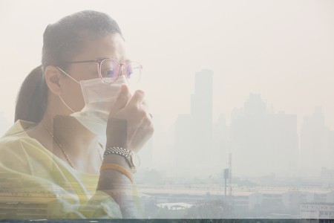
Protecting Our Health

Slide 12
Solutions and Sustainable Practices
- Renewable Energy: Shifting to renewable sources like solar and wind reduces air pollution and mitigates climate change.

Slide 13
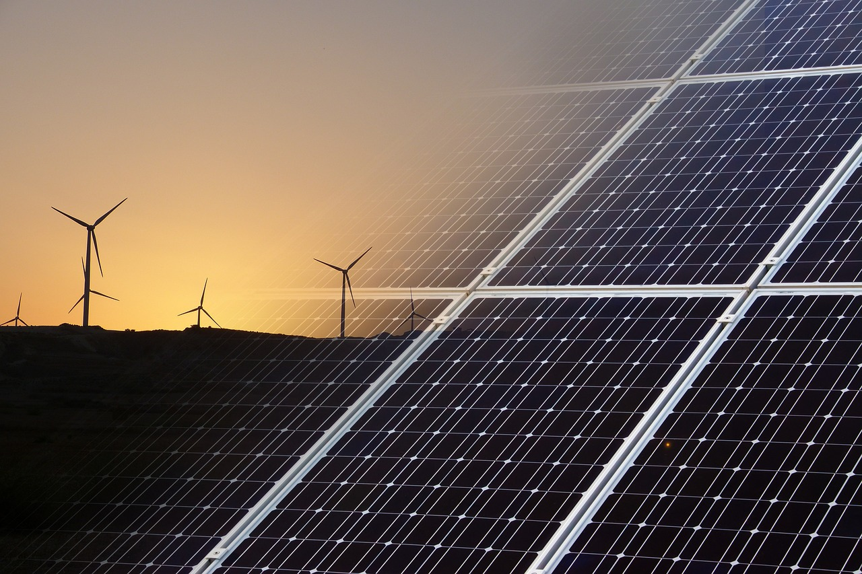
The Power of Renewable Energy

Slide 14
Community Action and Education
- Raise Awareness: Educate communities about pollution's causes and consequences to foster behavioral changes.

Slide 15
Together, We Can Make a Difference

